Slide 1
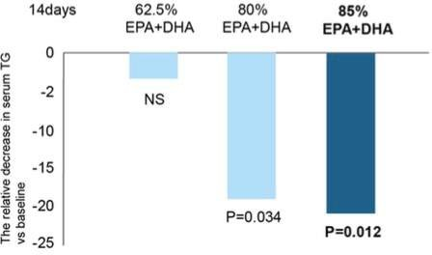
臨床實驗證明80%以上EPA/DHA濃度 才有降血脂能力
N=111
5.1g
5.1g
5.1g
Prostaglandins, Leukotrienes and Essential Fatty Acids 75 (2006) 19–24

Slide 2
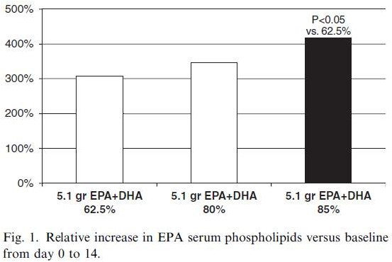
製劑EPA/DHA濃度越低，生體可用率越低
Prostaglandins, Leukotrienes and Essential Fatty Acids 75 (2006) 19–24

Slide 3
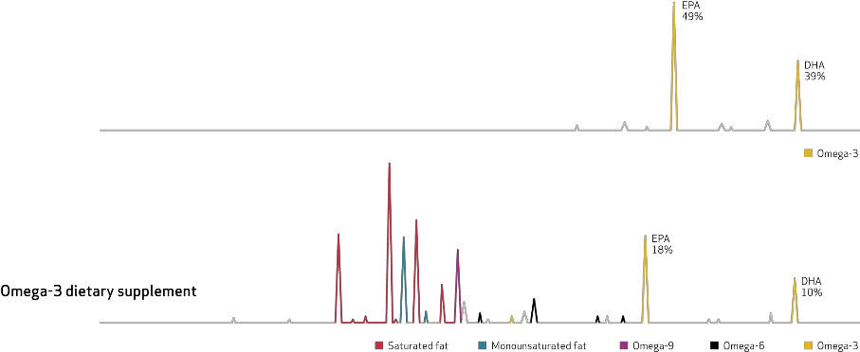
EPA/DHA濃度越低代表"雜油"越多
Data on file, Pronova BioPharma

Slide 4
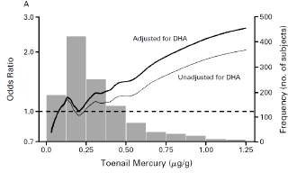
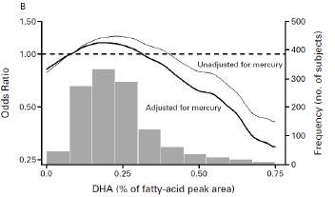
2002 NEJM研究發現 :
重金屬會抵銷Omega-3的好處
Conclusions : The toenail mercury level was directly associated with the risk of myocardial infarction, and the adipose-tissue DHA level was inversely associated with the risk. High mercury content may diminish the cardio protective effect of fish intake.
(魚或魚油內的重金屬可能會抵銷Omega-3對心血管的好處!!!)
心肌梗塞發生率
指甲內汞含量(ppm)
脂肪組織內DHA含量
(N Engl J Med 2002;347:1747-54.)

